Slide 1


Administrating SQL Server with PowerShell dbatools
Rob Sewell @sqldbawithbeard https://sqldbawithAbeard.com

Slide 2
Sponsors

Slide 3
Speaker Questionnaire
Name : Rob
Occupation : DBA, Automator, Do-er, Trainer
Interests : PowerShell, Automation And SQL (PaaS geddit?)
Interesting Fact : Beard. (Still) Plays Cricket, Flies Drone
Speaker : SQL Saturdays, SQL Relay, PowerShell Events
Community : SQL South West , SQL Sat Exeter , PowerShell VG, PowerShell Conference EU Organiser, dbareports, dbatools, SQLDiagAPI – For Consuming SQL Server Diagnostics API, MVP
Crashes

Slide 4
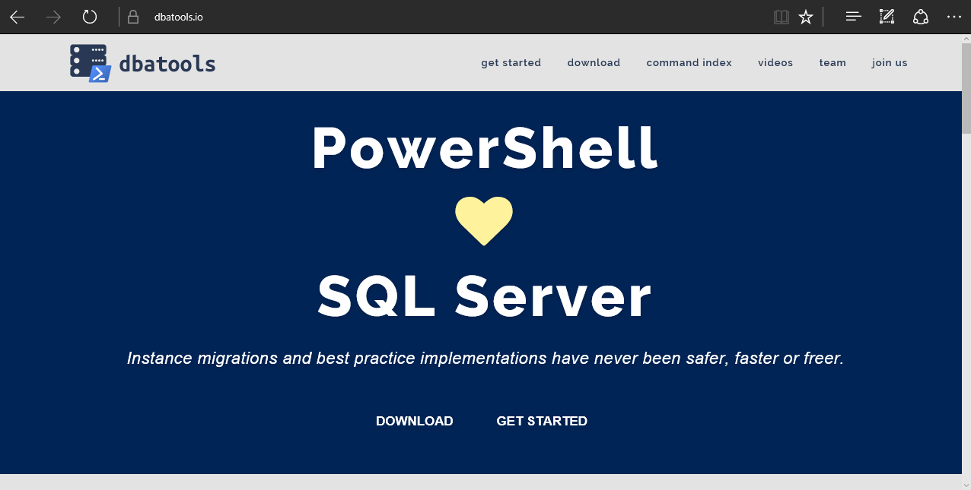
dbatools

Slide 5
requirements
Minimum
Client
PowerShell v3
SQL Server Management Studio / SMO 2008 R2
Server
SQL Server 2000
No PowerShell for pure SQL commands
PowerShell v2 for Windows commands
Remote PowerShell enabled for Windows commands
Recommended
Client
PowerShell v5.1
SQL Server Management Studio / SMO 2008 R2
Server
SQL Server 2008R2+

Slide 6
installation
PowerShell Gallery (PowerShell v5+)
Install-Module dbatools
Install-Module dbatools –Scope CurrentUser
GitHub – dbatools.io/git
Invoke-Expression (Invoke-WebRequest https://dbatools.io/in)
Clone repo found at dbatools.io/git, Import-Module dbatools

Slide 7
demos

Slide 8



Questions?
?
?
?
?
?
?
?
?
@sqldbawithbeard
robsewellsqldba
?
?
?
?
?
?
?
?
sqldbawithAbeard.com

Slide 9
More Help
Extensive documentation within each command Get-Help Start-DbaMigration –Detailed
Extensive documentation on dbatools.io
dbatools.io/Start-DbaMigration
dbatools.io/Repair-DbaOrphanUser
Some commands have videos
dbatools.io/youtube

